Slide 1
NYC Citi Bikes
Data insights and recommendations for logistical improvements
Notes:
This presentation aims to make recommendations for logistical improvements for Citi Bikes based on data collected during customer journeys

Slide 2
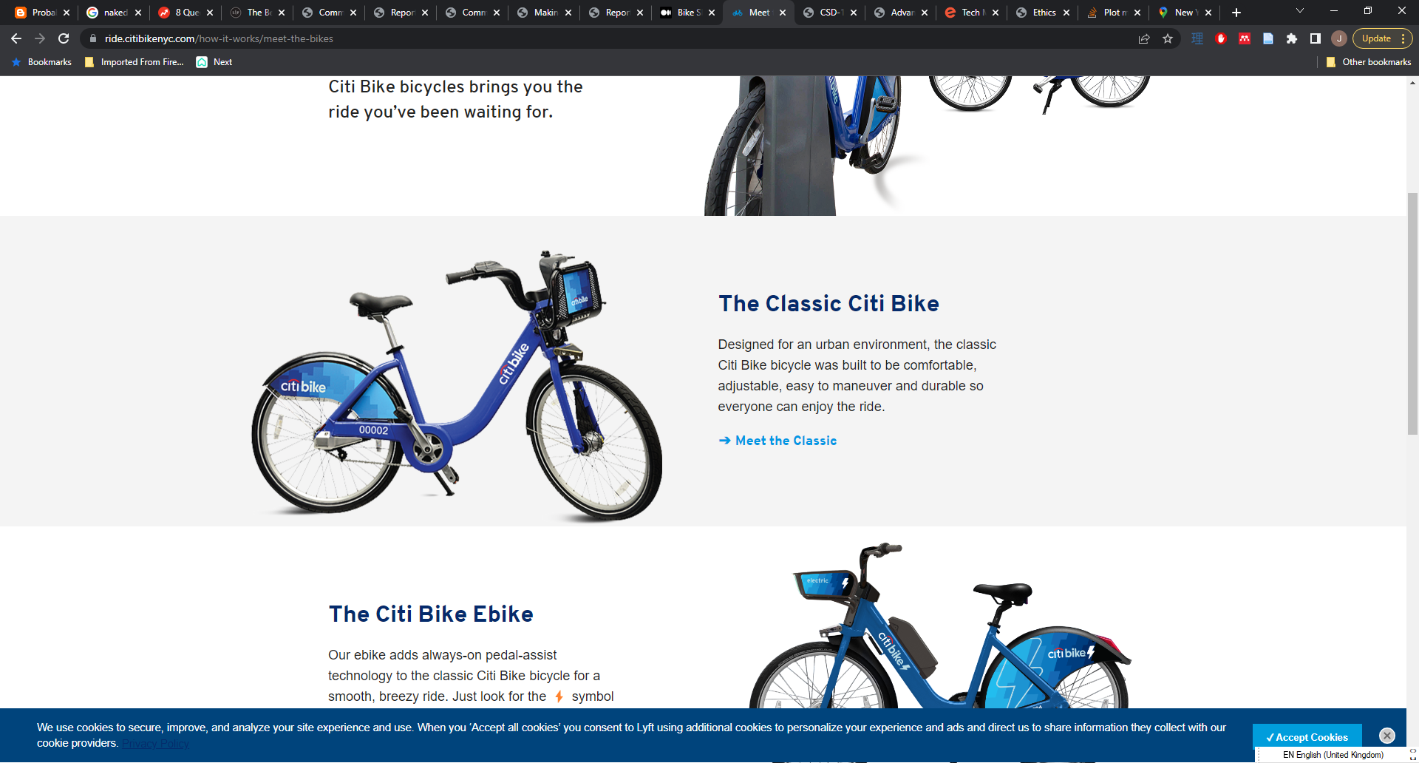
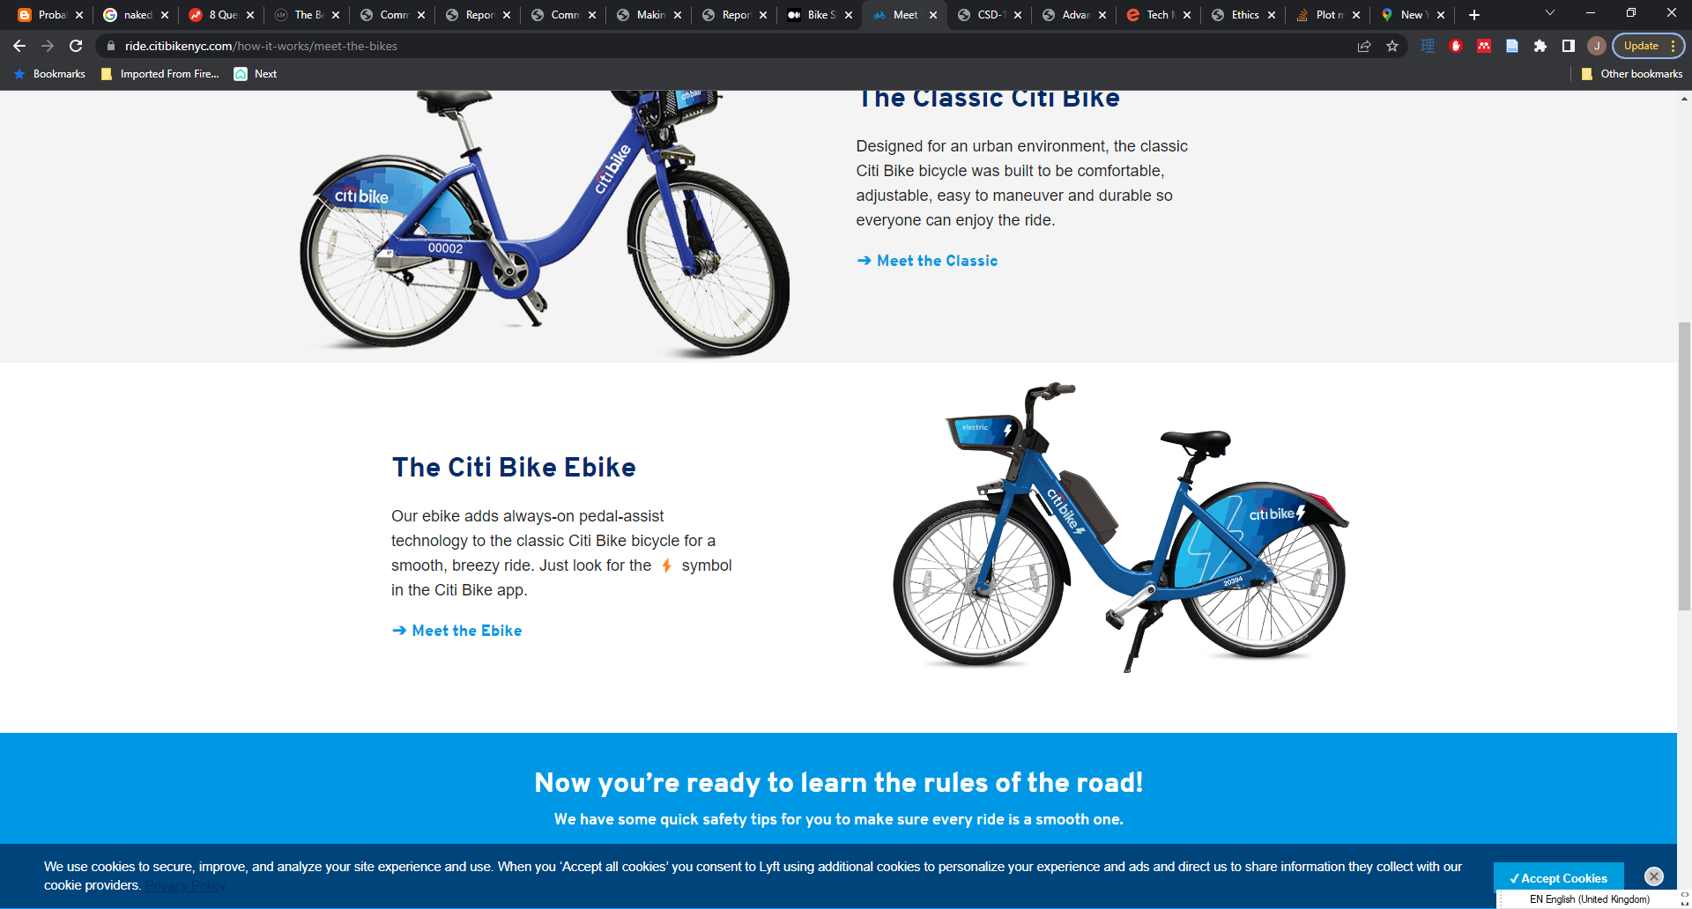
Business question
How can we improve resource allocation at Citi Bikes?
Where should we allocate more bicycles?
When is the best time to undertake maintenance on the bicycle fleet?
What data do we need to collect next to improve resource allocation?

Slide 3
Data collected
Before Ride
Bicycle ID (bike_id)
Customer information
At point of hire
Start date and time of ride (start_time)
Station the bike was hired from (start_station)
At end of hire
End date and time of ride (stop_time)
Station the bike was returned at (end_station)
type (subscriber/ customer)
birth_year
gender
Latitude and longitude of station (start_lat, start_long)
Latitude and longitude of station (end_lat, end_long)
nyc_bikes
bike_id
start_time
stop_time
start_station
start_lat
start_long
end_station
end_lat
end_long
type
birth_year
gender
Notes:
The key data needed for answering the questions was data about the date and time of the hires b/c this allowed me to spot patterns across time (e.g. what hours of the day were busiest, which days of the week had the most hires). These patterns are useful for understanding when more bikes need to be available and when not so many bikes are needed (which is a good time for maintenance). The station information was also instrumental to understanding which stations were most used and might benefit from additional bike availability.

Slide 4
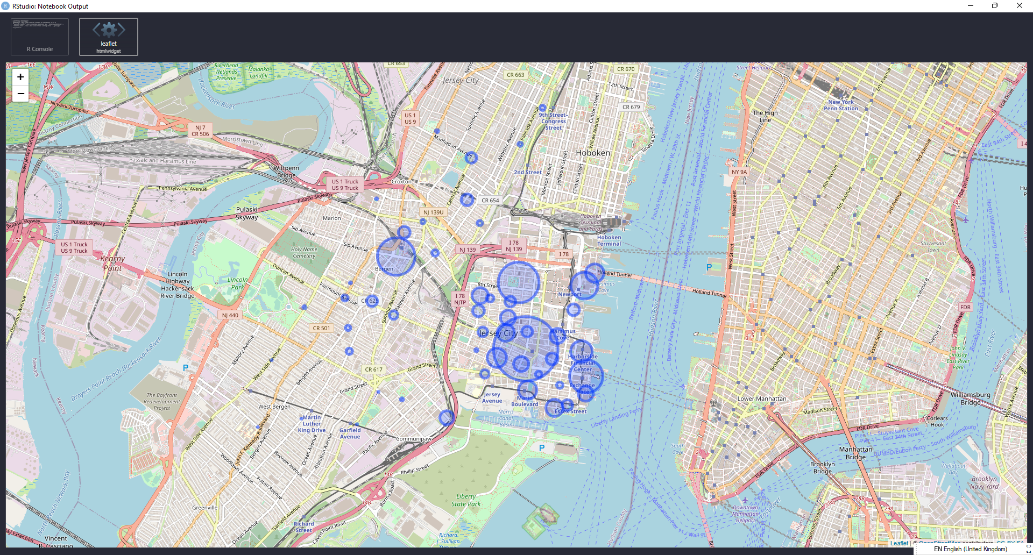
Limitations to the dataset
Biased sample
Small selection of bikes
Limited to only stations in Jersey City
Recommendations might not apply to other areas covered by Citi Bike
Notes:
E.g. there may be more bike usage for tourism in Manhattan, which might mean that the busier days and times are different for that area.
Only one ride ended somewhere other than Jersey City – this is probably because cycling into Manhattan requires use of a ferry

Slide 5
Highest and lowest use stations
Station number | Number of rides
3186 | 434
3203 | 278
3195 | 250
3277 | 8
3190 | 4
3188 | 1
Notes:
Based on data from the station the customer started their journey at.
We should review the availability of bikes at these stations – more bikes may need to be allocated to the highest use stations and fewer bikes might need to be allocated to lower use stations. The full table will be available in the report.

Slide 6
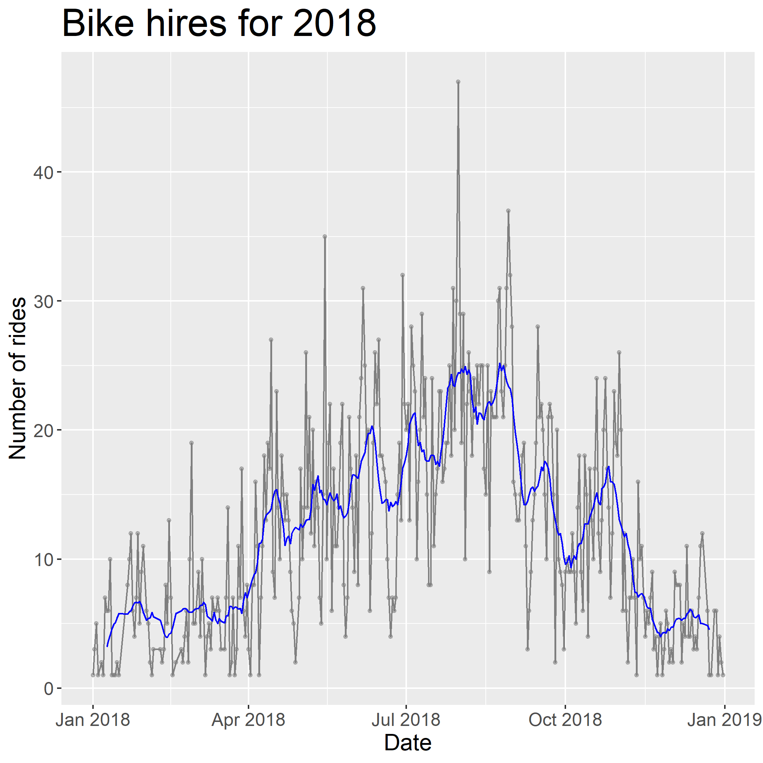
Trends over time
Bike usage is lowest in the winter
Bike hire increases around April and starts to decrease again in November
The best month for longer scheduled maintenance is February
Notes:
Starts to increase in April (326 rides), peaks in August (728 rides), starts to decrease again in November (213 rides) and is lowest in February (112 rides)

Slide 7
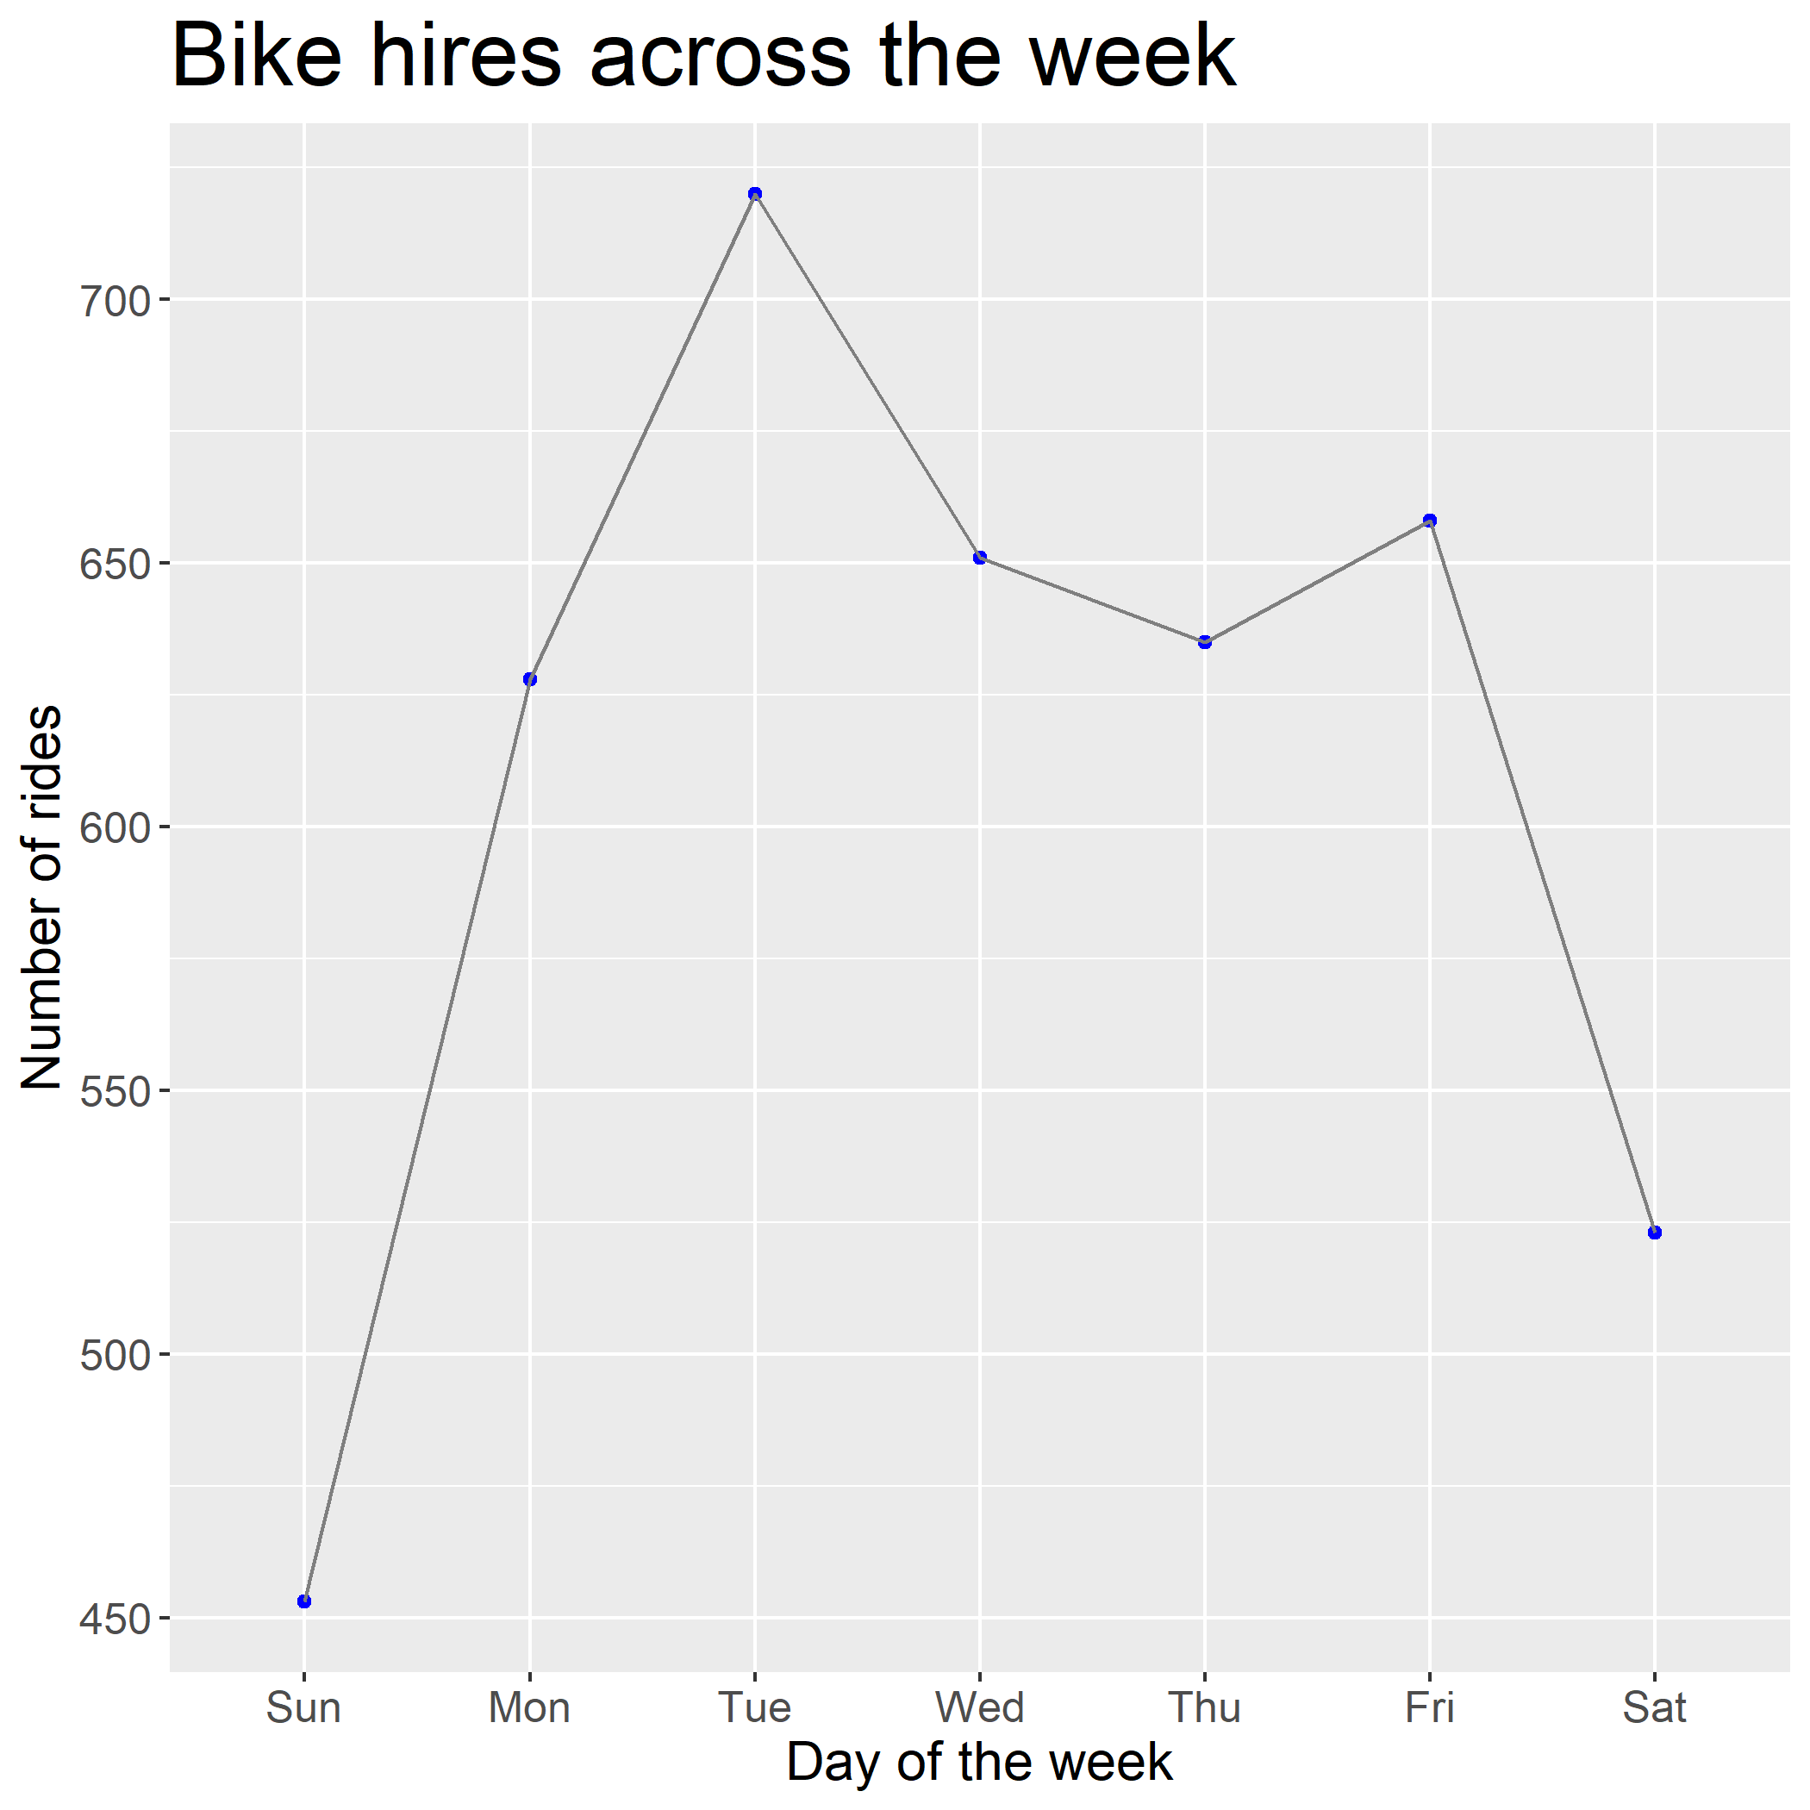
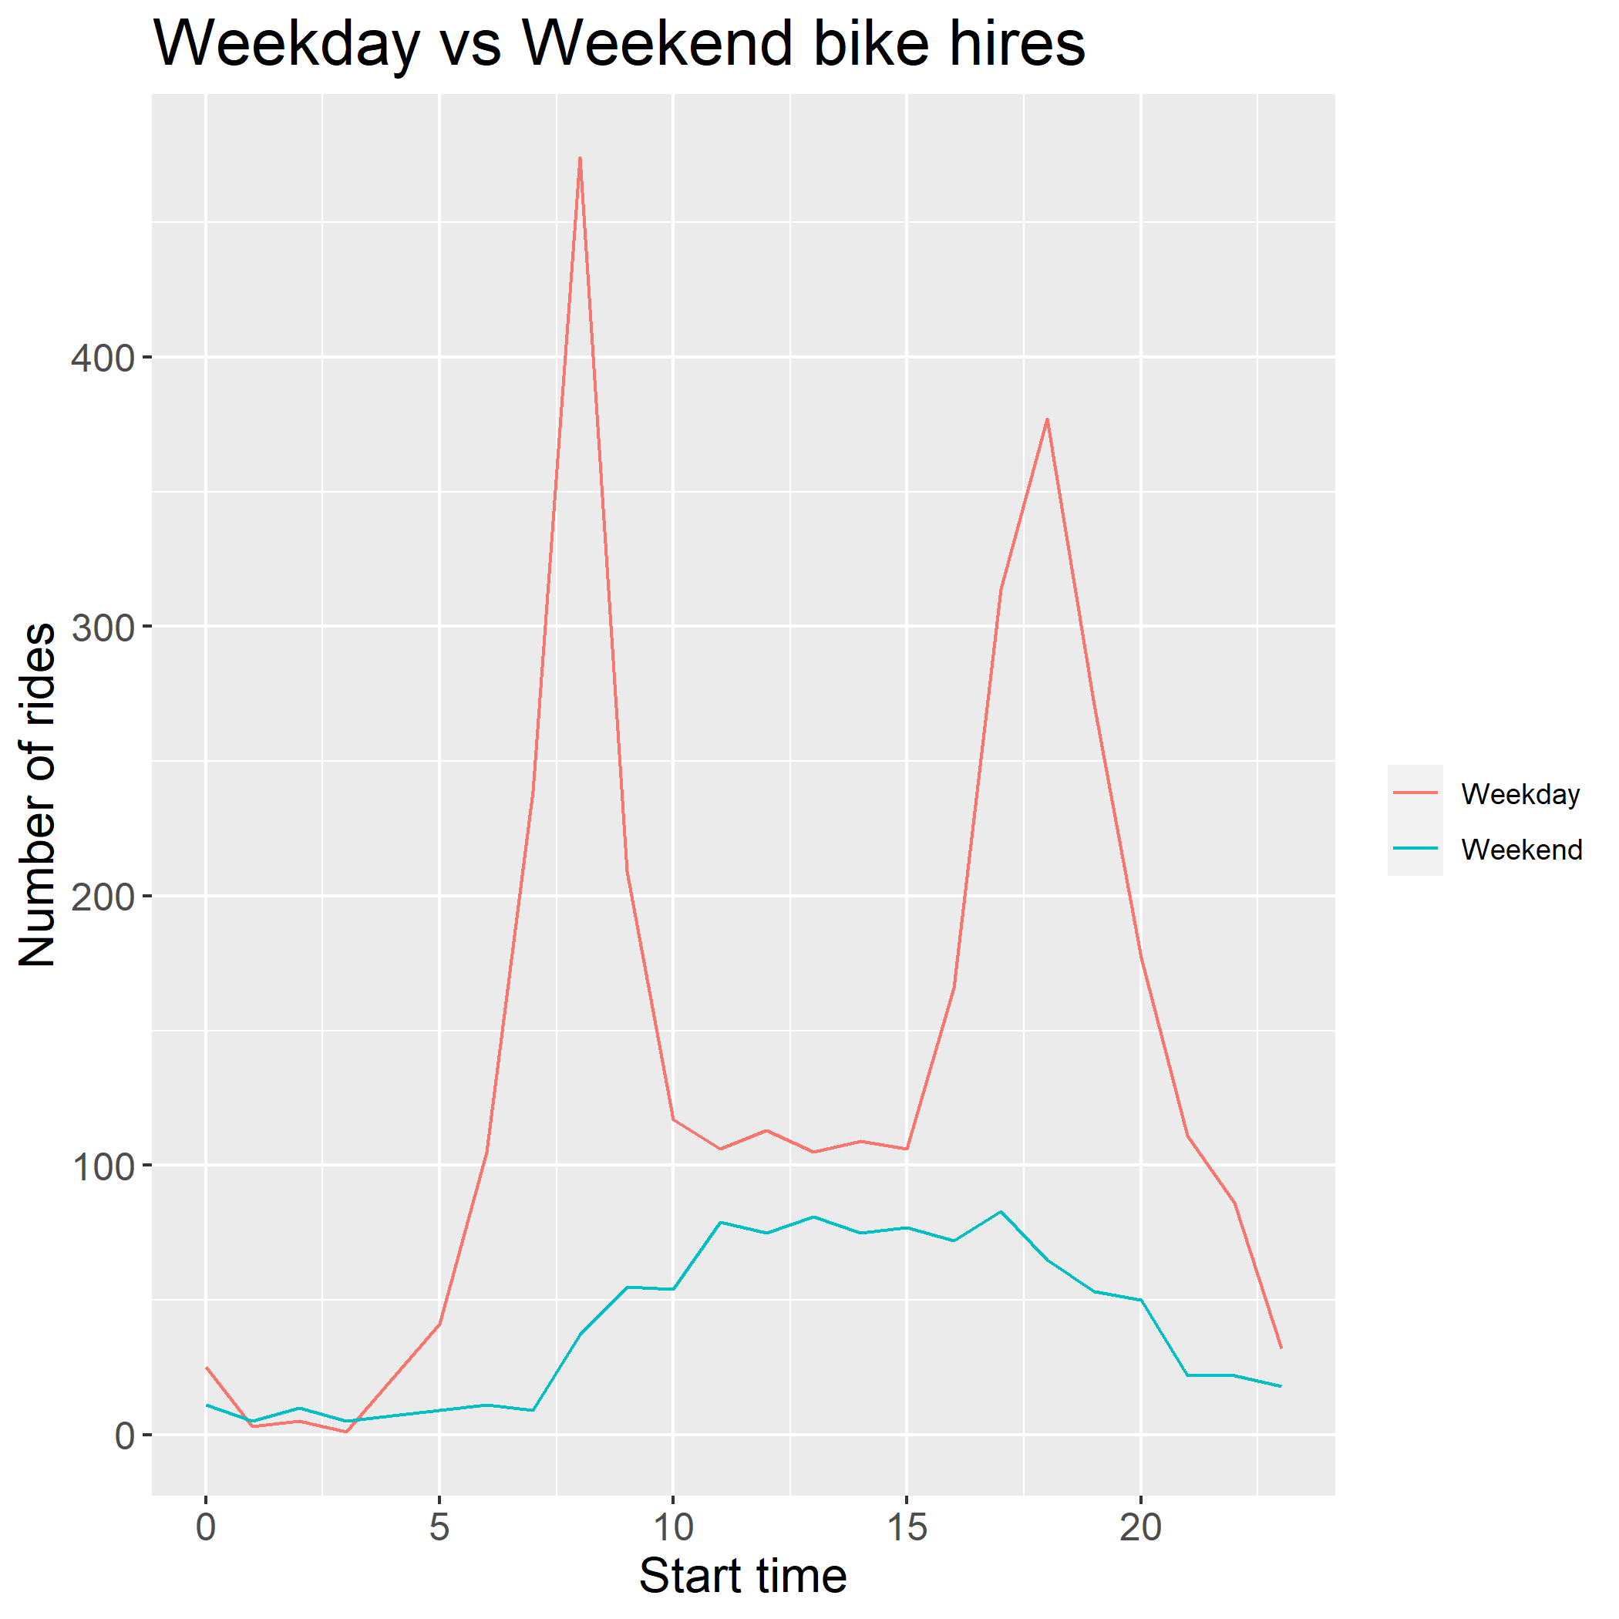
Trends over time cont’d
Number of rides increases on standard work days (Mon-Fri)
Sunday saw the least number of rides (453)
Tuesday saw the highest(720)
The number of rides peaks at 8AM and 6PM
Regular maintenance should be scheduled in the late evening/outside of commuting times

Slide 8

Conclusions and recommendations
Review the number of bikes at high/low traffic stations to improve effective allocation of bicycles
Schedule any necessary longer maintenance for winter months when usage is lowest (February)
Review bike availability during the weekday rush hours
Schedule regular maintenance on bikes in the evening when usage is lowest.
Collect data for other areas of service where usage patterns will differ.
Consider collecting data about how many bikes are available to check availability over time.

